Slide 1


Focus Web Developer
Week 1 - Lesson 2
Notes:
Welcome your class, think about what is the hook to engage your students right out of the starting gate.

Slide 2
Lesson Topics
Review
General Programming Languages
Specific Problem Domain Programming Languages
JavaScript Introduction
JavaScript Environments
ECMA Script
Notes:
Pre-test
Two-way learning

Slide 3

Review
A quick review of yesterday:
Programming is manipulating data
Computer architectures
Computer instructions
Programming paradigms

Slide 4

Discussion
Work with your neighbor and answer the following questions from yesterday;
What is HTML?
What is CSS3?
What is a Problem Domain?
How does JavaScript fit in with HTML and CSS?
Notes:
Students will find a partner to work with and discuss the questions:
What is your experience with code?
Have you ever built a website before?
Do you know any programming languages?

Slide 5
General Programming Languages
Some computer programming languages can be used for multiple Problem Domains
These are called General Programming languages

Slide 6



General Programming Languages
Examples:
C
Java
Python
Notes:
Images –
C - https://www.techbaz.org/Course/img/c-logo.png
Java - https://duckduckgo.com/?q=Java+logo&t=brave&iar=images&iax=images&ia=images&iai=http%3A%2F%2Fblog.idrsolutions.com%2Fwp-content%2Fuploads%2F2014%2F06%2Fjava_logo.jpg
python - https://www.101computing.net/wp/wp-content/uploads/python-logo-1.png’

Slide 7
Discussion
Where does JavaScript fit in?
Is it a Specific Problem Domain computer programming language, or is it a General Programming Language?
Do a quick search and share your findings with the class
Where does JavaScript fit in?
Notes:
Students will find a partner to work with and discuss the questions above.
JavaScript is a specific problem domain language that deals with web development.
EXTRA BACKGROUND FOR INSTRUCTOR (this information will be covered in more detail later in this presentation)
Within web development there are two sub problem domains – front end and back end web development. JS originally only dealt with front end web development, but it now deals with both front and back end web development.

Slide 8

JavaScript
JavaScript is a Specific Problem Domain Programming Computer Language
The Problem Domain that JavaScript works well within is Web Development
Notes:
Image
https://careerfoundry.com/en/blog/uploads/learningtoprogram-min.jpg

Slide 9

JavaScript
Introduction to
Notes:
Image - https://duckduckgo.com/?q=JavaScript+logo&t=brave&iar=images&iax=images&ia=images&iai=https%3A%2F%2Fupload.wikimedia.org%2Fwikipedia%2Fcommons%2Fthumb%2F9%2F99%2FUnofficial_JavaScript_logo_2.svg%2F1200px-Unofficial_JavaScript_logo_2.svg.png

Slide 10
First things first – JavaScript is not Java!

Slide 11
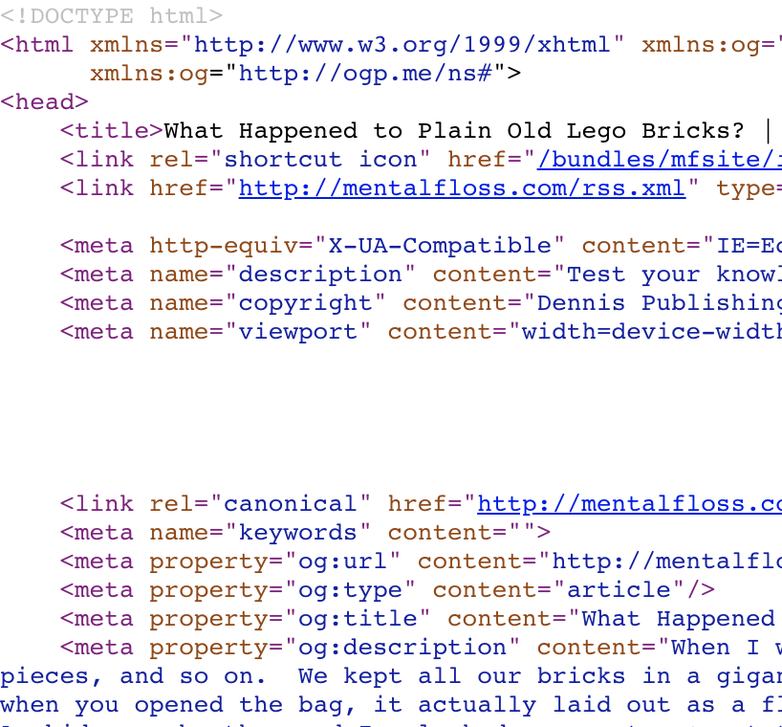
JavaScript vs. Java
Two totally different programming languages
Only thing in common is that they are both computer programming languages

Slide 12

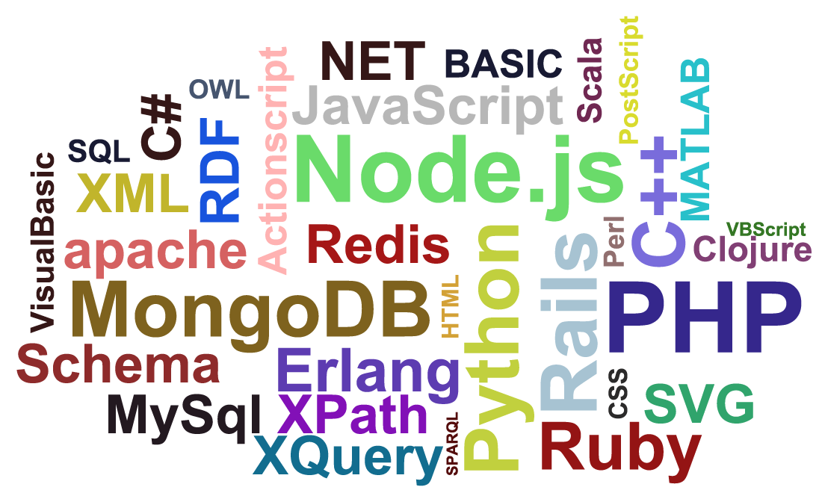
JavaScript Beginnings
JavaScript started out as a scripting language
A scripting language:
uses an interpreter instead of a compiler
controls an environment
Notes:
Images
Languages - https://external-content.duckduckgo.com/iu/?u=http%3A%2F%2Fscreenshot.ru%2Fupload%2Fimages%2F2014%2F01%2F07%2FrQJ9kh8.png&f=1&nofb=1
Circle - https://i.pinimg.com/originals/63/98/f6/6398f61cdd8d9ea570d48b7c68d33132.png

Slide 13
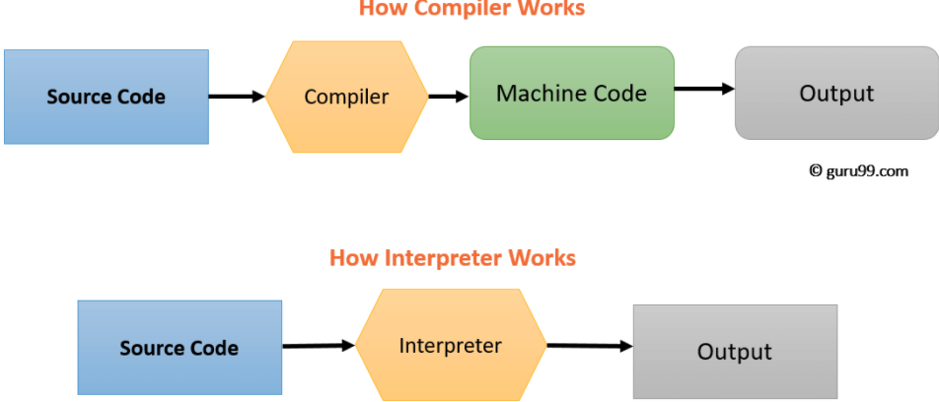
Interpreter vs. Compiler
Notes:
It should be noted that both the interpreter and the compiler take high level code and turn it into machine code which can then be run by the computer to create an output. The green box in the compiler example indicates that a new file is created by the compiler which is then run by the computer.
Image - https://www.guru99.com/images/1/053018_0616_CompilervsI1.png

Slide 14

JavaScript Environments
An Environment can mean:
An operating environment
where the program runs and is available to the user
A developing environment
where code is written and tested before it is published for the user
Notes:
Gears - https://cdn.vectorstock.com/i/1000x1000/18/59/cog-gear-cogs-gears-and-tools-isolated-vector-8541859.jpg

Slide 15

JavaScript Operating Environment
Web Browsers are examples of operating environments:
Chrome
FireFox
Microsoft Edge
Safari
Notes:
Image from https://wanyingcom125.files.wordpress.com/2014/02/browsers-battle.jpg

Slide 16



JavaScript Developing Environments
There are varying levels of developing environments:
Text Editors
code can be written, but not tested
Example Programs: Atom, Notepad, Brackets
Notes:
Images from:
Brackets - https://duckduckgo.com/?q=brackets+logo&t=brave&iar=images&iax=images&ia=images&iai=https%3A%2F%2Fupload.wikimedia.org%2Fwikipedia%2Fcommons%2Fthumb%2F4%2F4c%2FBrackets_Icon.svg%2F1200px-Brackets_Icon.svg.png
Atom - https://duckduckgo.com/?q=atom+text+editor+logo&t=brave&iar=images&iax=images&ia=images&iai=https%3A%2F%2Fdl2.macupdate.com%2Fimages%2Ficons256%2F53196.png%3Fd%3D1518722998
Notepad - https://duckduckgo.com/?q=note+pad+windows+logo&t=brave&iar=images&iax=images&ia=images&iai=https%3A%2F%2Fdewfromtheheavens.files.wordpress.com%2F2017%2F03%2Fnotepad-logo.jpg%3Fw%3D736

Slide 17
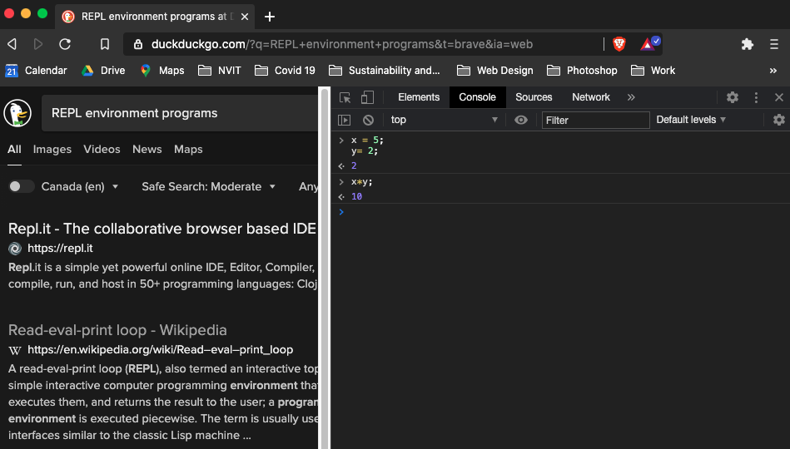
JavaScript Developing Environments
There are varying levels of developing environments:
Read-Evaluate-Print-Loop (REPL)
small pieces of code can be written and tested
good for debugging code
Example Programs: command line, console
Notes:
Image – screen shot from Nick’s computer

Slide 18



JavaScript Developing Environments
There are varying levels of developing environments:
Integrated Development Environment (IDE)
code can be written, compiled, tested and debugged all with one program
very efficient workflow
Example programs: Visual Studio, PyCharm, Eclipse
Notes:
Images
Visual studio - https://duckduckgo.com/?q=visual+studio+logo&t=brave&iax=images&ia=images&iai=https%3A%2F%2Fdevblogs.microsoft.com%2Fvisualstudio%2Fwp-content%2Fuploads%2Fsites%2F4%2F2019%2F01%2Fvisualstudio-1.png
PyCharm - https://duckduckgo.com/?q=Pycharm+logo&t=brave&iar=images&iax=images&ia=images&iai=http%3A%2F%2Ftipsonubuntu.com%2Fwp-content%2Fuploads%2F2017%2F06%2Fpycharm-ide-logo.jpg
Eclipse - https://duckduckgo.com/?q=eclipse+logo&t=brave&iax=images&ia=images&iai=http%3A%2F%2Fstatic.jboss.org%2Frhd%2Fimages%2Fimages_icons_products_products_eclipse_logo-5.png

Slide 19
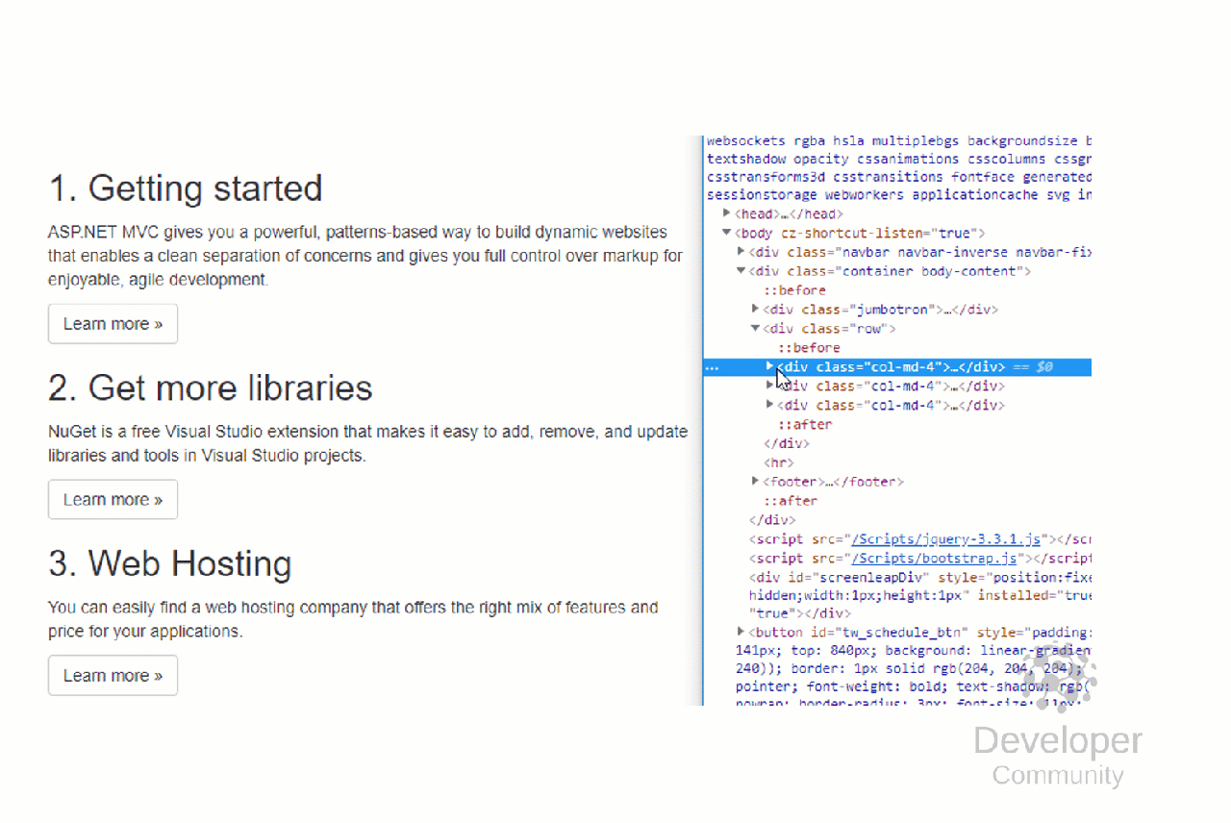
JavaScript Beginnings
Originally JavaScript was designed to control Web Browsers to animate/move objects such as text and images
this was its only Problem Domain… until recently…

Slide 20


JavaScript Beginnings
Now, JavaScript is being used as a problem solver in many different Problem Domains

Slide 21
Discussion
What do you think the problem domain(s) of JavaScript is(are)?
Share your coding knowledge
Notes:
Class discussion – answer on next slide

Slide 22
JavaScript Problem Domains
Within the Problem Domain of Web Development there are two sub- Problem Domains:
Front End Web Development
Back End Web Development
Notes:
JavaScript’s main problem domain is web development. Within the problem domain of web development there are two problem domains – front end web development and back end web development

Slide 23
JavaScript Front End Development
Front End Web Development
creating code that controls what we see in the Web Browser
is what JavaScript was originally developed for
Examples: images moving, animating text, slide shows

Slide 24
JavaScript Back End Development
Back End Web Development
creating code that adds functionality to a website
getting information from a data base
connecting to other websites
processing data

Slide 25

JavaScript Beginnings
Historically, Front End Web Development used one programming language, and Back End Web Development used another

Slide 26
JavaScript Beginnings
To complete Front End Web Development you would need to know:
HTML to create web pages
CSS to style web pages
JS for functionality

Slide 27
JavaScript Beginnings
To complete Back End Web Development you would need to know:
MySQL or SQL to access the data from a data base
Data base technologies to store data for the website
PHP or another Back End Problem Domain language for Back End functionality

Slide 28

JavaScript Beginnings
In summary, historically, to complete Web Development you would need to know:
HTML
CSS
MySQL and SQL
DataBase technologies
JavaScript
PHP or another Back End Problem Domain language
Notes:
Image
https://duckduckgo.com/?q=face+down+on+computer+stick+person&t=brave&iar=images&iax=images&ia=images&iai=https%3A%2F%2Ft4.ftcdn.net%2Fjpg%2F02%2F25%2F12%2F71%2F240_F_225127102_AJwajJziT9qzoHjKQdzgQIdUbsv8ZFOa.jpg

Slide 29

JavaScript Beginnings
Now, for complete web development you only need to know:
HTML to create web pages (front end)
CSS to style web pages (front end)
JS for functionality (front and back end)

Slide 30
Discussion
Are you currently more interested in front end web development or back end web development?
Sharing your coding knowledge
Notes:
Pair the students off into small groups for discussion. Ask them to share with the larger group when they return.

Slide 31

ECMAScript
European Computer Manufacturer Association (EMCA)
JavaScript began as ECMAScript
Originally developed by Netscape (one of the first widely used web browsers) to ensure standardization and compatibility for web browsers
Notes:
Image - https://upload.wikimedia.org/wikipedia/commons/thumb/0/08/Netscape_icon.svg/1200px-Netscape_icon.svg.png

Slide 32
ECMAScript Versions
ES7
Currently being developed
ES6 aka ES2015
most commonly used today
ES5
many older websites use this still use this today
We will be concentrating on techniques that are based on ES5 and that are compatible with most versions of JavaScript you will encounter in the field.
ES3
Many older websites still use this
Used up until 2010

Slide 33
Activity 1
Watch the video A Brief History of JavaScript by the Creator of JavaScript.
https://www.youtube.com/watch?v=3-9fnjzmXWA
Create a word document and answer the following
Why was JavaScript created?
How long did it take to develop JavaScript?
What does JIT mean?
Brief history of JavaScript
Notes:
Ask the students to send you their documents and provide them with feedback tomorrow.
This video is a bit over everyone’s head and they would probably get more from a lower level video that explains the history of ECMA and JS.

Slide 34

Class Wrap-up
How was your day?
How are you finding the course so far?
Notes:
Post test: end of the day Q/A – to include feedback and review of the day.
Were the day’s goals met (reference slide 2)?
Transition: what’s coming up tomorrow?

Slide 35
Image Credits
No image credits today

